Slide 1

Advancing Health & Wellness Management
March 2019

Slide 2
Nature can refuse to speak, but she cannot give a wrong answer.
Charles Brenton Huggins, MD
Nobel Prize for Medicine or Physiology, 1966
Notes:
Translating complex biological language

Slide 3

Healthy
Healthy
Predisposed
Under The Radar
Healthy
On The Ledge
Healthy
Walking Wounded

Slide 4
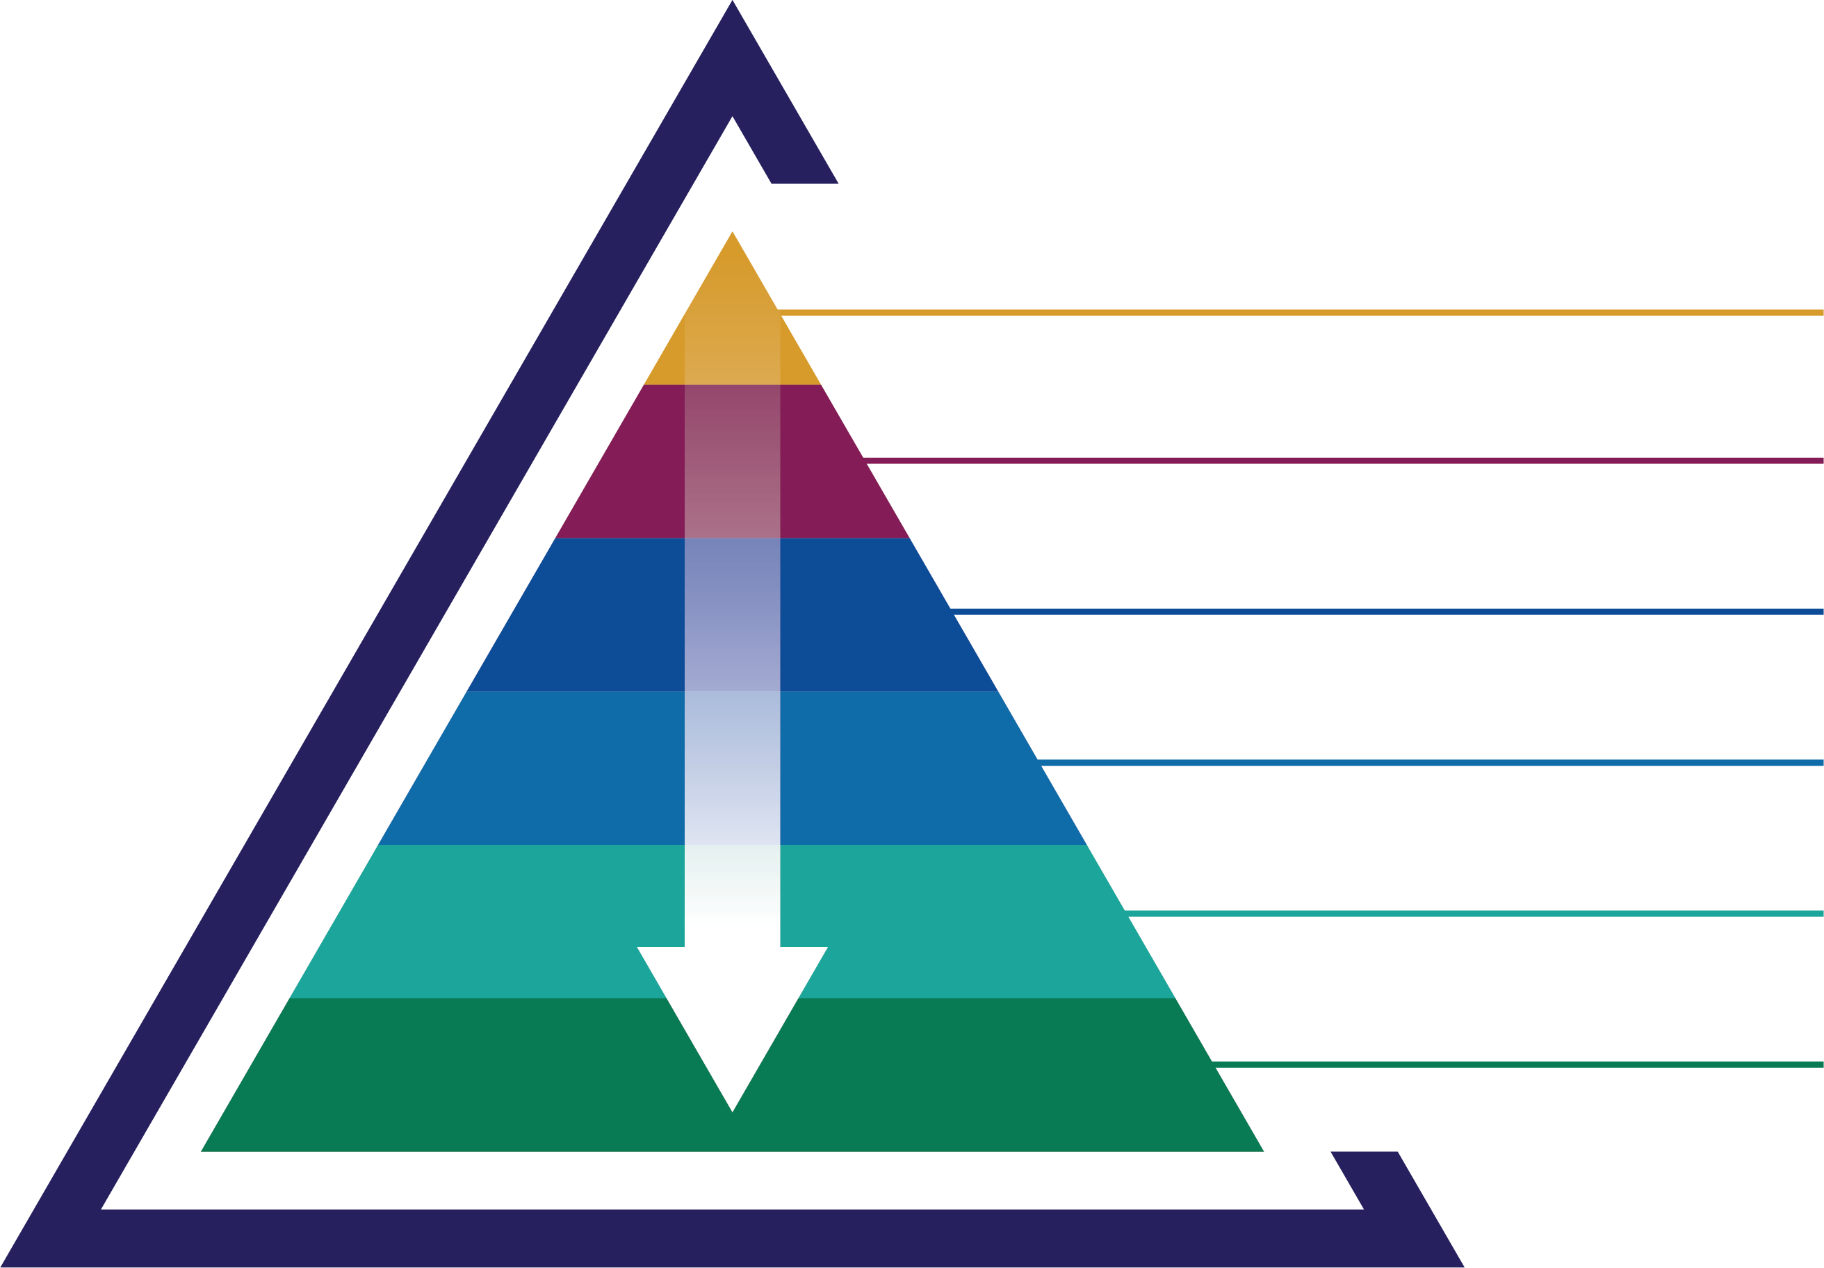
Why would the world be interested in what we do?
THE TOP 5%
Because we have the power to move precision health from rhetoric to reality.
WALKING WOUNDED
UNDER THE RADAR
ON THE LEDGE
PREDISPOSED
“HEALTHY”

Slide 5

To understand human biology in real time you must translate the “language” of proteins, repeatedly over time.
SomaLogic leads the world in translating proteins into meaningful health information across conditions and markets.
We are creating a truly transformational protein-based precision health information company.
Notes:
Three main points:
Proteins are the structural and functional molecules of life as it is lived in real time
SomaLogic is the clear leader in both measuring and in translating protein changes into meaningful health insights
Our goal is to leverage our technology and rapidly growing knowledge into the leader in health information

Slide 6
Precision health starts with molecular big data
DNA
Hereditary material that encodes functional biological molecules
mRNA
Molecule that carries DNA “directions” for protein synthesis
Proteins
Primary functional and structural molecules for all biological processes
From static to dynamic measurements
one and done
repeat regularly
Notes:
Precision comes about through increasingly finer measures of the individual across thousands of molecules
The movement towards precision medicine began with DNA (genomics) for historical and technological reasons, now a 100B market. But DNA is fairly static, generally the same in most cells of your body throughout life. Has not provided as much useful clinical information as hoped (though much biological information)
Companies are brining their DNA technologies to bear on RNA measurements, which are more dynamic and specialized in cells and tissues, and potentially closer to clinical use. However, RNA expression is not highly correlated with the actual protein expression, and usually does not give a systemic view of health.
Proteins, as the primary functional and structure molecules of biology, are also the molecules underneath health and disease processes, often changing well before symptoms appear. They reveal health status in the moment, in real time. They also reflect past health, and foretell future health trajectory. The ability to measure thousands of proteins regularly and reproducibly would transform medicine and healthcare

Slide 7



The SOMAscan® proteomic assay powers health and wellness insights
Single blood sample
5,000 proteins measured
Insights that reveal current state of health and future trajectory
CLIA certified/CAP accredited Clinical Laboratory
Boulder, CO, USA
CE marked insights from the SOMAscan assay
Oxford, UK
Notes:
Liz will present

Slide 8

Plasma protein scanning is viable as a single source of health information
Vitality
Cancer
Cardiovascular Health
Musculoskeletal Health
Weight Management
Inflammation
Metabolic Health
Immunity
Nutrition
Mental Health
Notes:
Liz will present
Voiceover: this not an exhaustive list, these are examples of some of the things we’re evaluating right now

Slide 9




Insights at scale can drive value across the Quadruple Aim
Improved Patient Outcomes
Improved Patient Experience
Lower Cost of Care
Improved Provider Experience
Better risk classification focuses resources on those most in need
Comprehensive patient health profiles guide more precise clinical decision-making
Early diagnosis enables disease interception
Personalized treatment plans enable better care
Reports enable engaged conversation between patients
& providers about treatment plan
Personalized information empowers patients with how to improve their own health
Population-level risk drives more effective community intervention strategies
Population monitoring care pathway optimization
Comprehensive health and lifestyle profiles reduce clinical uncertainty and inform personalized treatment options
Easy to interpret reports for patients and providers facilitate discussion
Notes:
Liz will present

Slide 10
Insights may be used to address multiple areas of unmet need
Illustrative list of insights available near-term
Tailored clinical scenarios and impact
Insights
Clinical scenarios
Potential clinical utility of SOMAscan
Diabetes risk
Cardiovascular event risk
Kidney function
Liver fat
CHF subphenotype and prognosis
NASH diagnosis and prognosis
Smoking status
Alcohol status
Percent body fat and lean body mass
Visceral fat
Physical activity
Nutrition status
Social deprivation
Sleep quality
Manage intermediate CV risk | Stratify non-acute patient with suspicion of cardiovascular disease for appropriate diagnostic work-up and clinical intervention
Pre-surgical evaluation for bariatric surgery | Identify bariatric surgery candidate appropriateness according to health risk, and motivate engagement
Pre-surgical evaluation for elective surgery | Stratify elective surgery candidate according to risk and engage in shared decision-making around appropriateness of surgery
Manage CHF progression | Identify congestive heart failure patient likelihood to progress, understand sub-phenotype, and triage accordingly
Manage DM or CVD progression | Triage intensity of lifestyle and therapeutic interventions, according to existing diabetes mellitus or cardiovascular disease patient
Manage NASH diagnosis | Avoid liver biopsy in suspicion of non-alcoholic steatohepatitis (NASH) patient by assessing current and future liver fibrosis, inflammation, steatosis, and ballooning
Manage risk of diabetes | Provide results and coaching to pre-diabetes mellitus patient for engagement and behavioral change
Notes:
Liz will present
Focus of slide is that we have a variety of health / sickness related insights, as well as lifestyle / behavioral insights, and they can be used to address many different clinical scenarios. I’ll talk through the first clinical scenario and then open up the discussion for dialogue

Slide 11
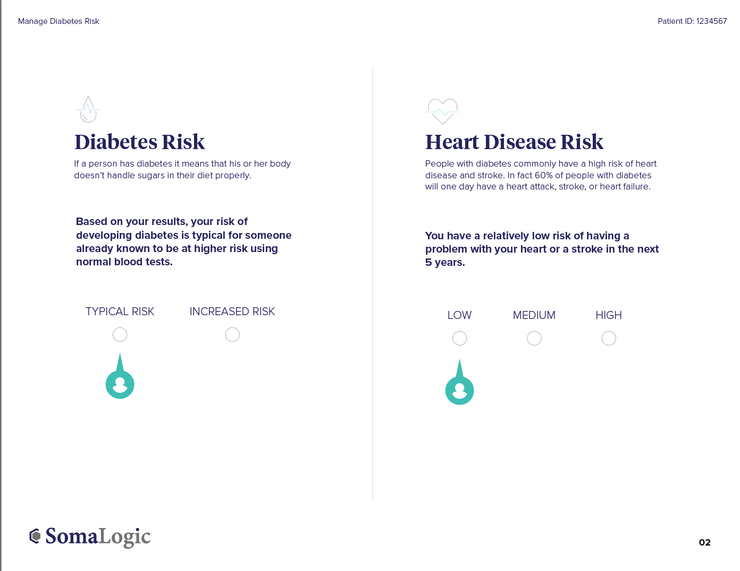
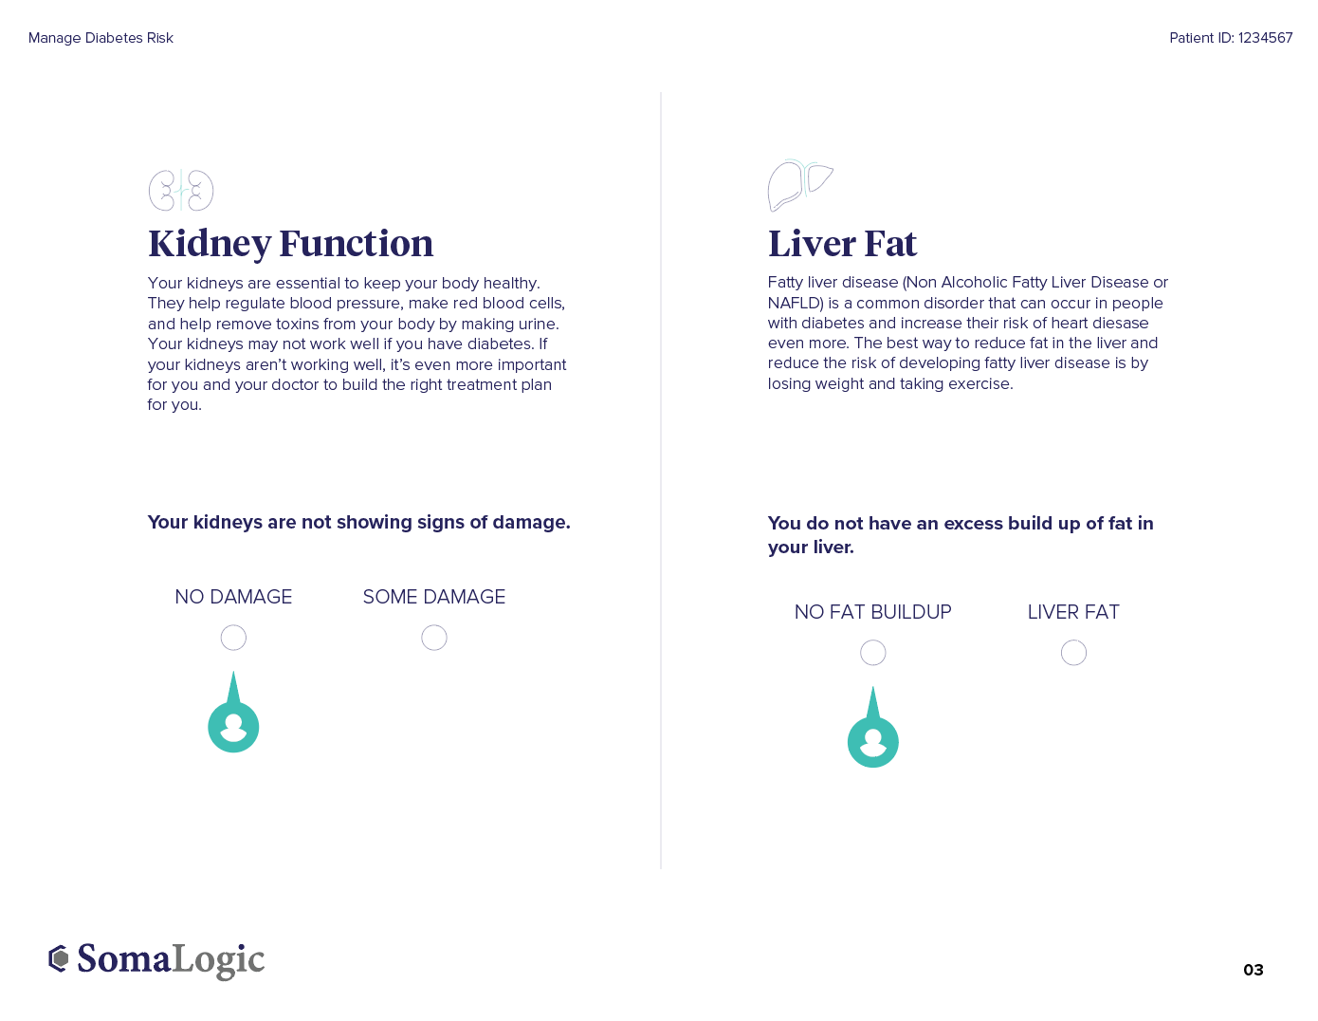
Illustrative participant report for pre-diabetes demonstrates tailored approach to health system needs
Sample Participant-Tailored Insights
Companion report delivered to care provider team with supporting medical education
Notes:
Rosalynn will present
Focus of slide is that we have a health system partner (Leeds) which wanted to address a specific problem (pre-DM), so we created a tailored report, in partnership with them, for their purposes

Slide 12
Knowledge base within the next 2 years
200,000 Samples
29,000 Events/Deaths/Hospitalizations
>1Bn Protein measurements
>1.5M participant-years of follow-up data
120 models of health state, behavior, diagnosis or prognosis
Moving into the US self-pay market with the first salvo of models in 2019
Partnering with leading risk-bearing integrated health systems in 2019-20 to demonstrate impact

Slide 13
SomaLogic’s currently qualified models (plasma protein only, V4 assay)
Current health state
Liver fat (mimics ultrasound)
Kidney function (mimics kidney filtration rate)
% body fat (mimics dual X ray absorption scan)
Lean body mass (mimics dual X ray absorption scan)
Visceral fat (mimics dual X ray absorption scan)
Cardiac fitness (mimics maximum oxygen extraction on treadmill)
Modifiable behaviors
Excess alcohol consumption (exceeding guidelines)
Cigarette smoking
Daily caloric expenditure from physical activity (mimics actigraphy)
Future health risks
Diagnosis of diabetes
Cardiovascular death
Heart attack
Stroke
Congestive heart failure
Probability of any event within the next 5 years

Slide 14
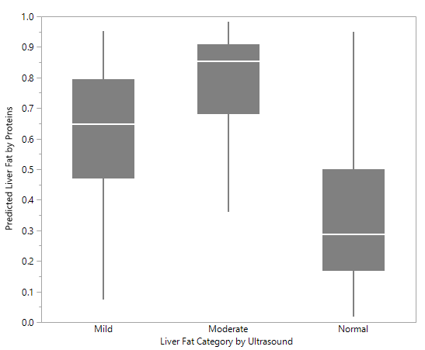
Liver fat (vs. ultrasound)
Key source of data:
UK cohort: 10,077 subjects with liver ultrasound results
Predefined performance criterion:
AUC of >0.8 for no steatosis vs. any steatosis on ultrasound.
Model output: 2 categories, fat (mild + moderate + severe combined [left of chart]) vs. no fat [right of chart]
Actual results:
A 94 feature protein model had an AUC of 0.83
Reference best alternative: age, sex, alcohol, statins, and diabetes: AUC of 0.64

Slide 15
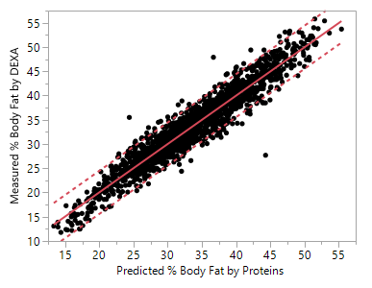
Percent body fat
Key sources of data:
UK cohort: 11,471 subjects with DEXA scan results
Predefined performance criterion:
A determination coefficient (r-squared) of at least 0.7 vs. Dual X-Ray Absorption (DEXA) scan results
Model output:
Continuous variable, % body fat
Actual results:
A 219 feature protein was developed
The r-squared was 0.90 in the 15% hold-out test set [see chart]
Best alternative model of age, sex, height and weight has an r-squared of 0.74

Slide 16
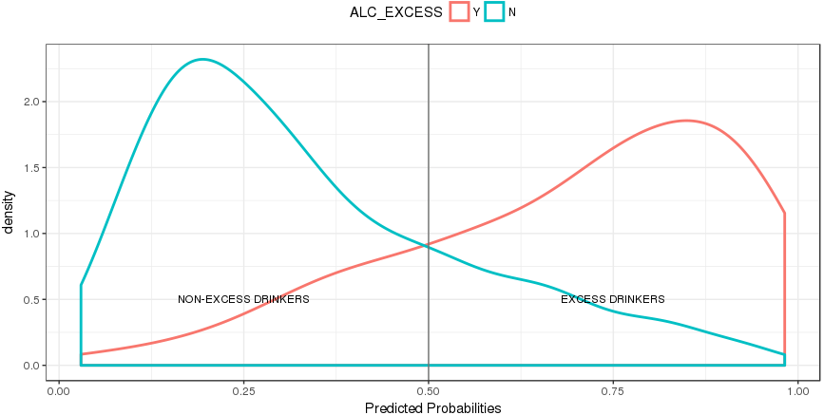
Alcohol “excess”, >14 units weekly
Key source of data:
UK cohort training set: Men: 4804, Women: 4851
Predefined performance criterion:
AUC of >0.7 vs. self reported units/week
Model output:
2 categories: above 14 units or below 14 units
Actual performance:
Two models were generated:
Metrics are on 30% hold-out fraction
Female protein model with 30 features: AUC of 0.87
Male protein model with 33 features: AUC of 0.82
Frequency distribution
Protein model predicted probability
(females shown)

Slide 17
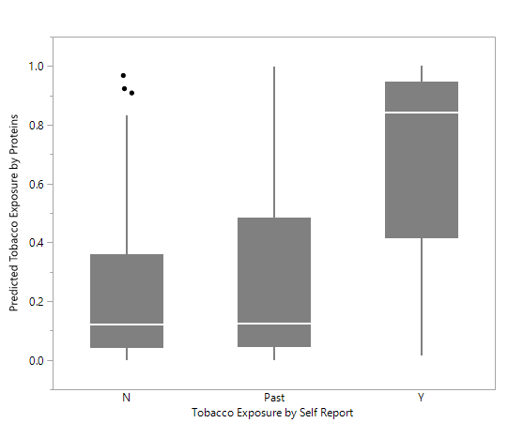
Cigarette smoke exposure
Key source of data:
Covance (US), 1029 subjects
Predefined performance criterion:
AUC of >0.8 vs. self reported cigarette smoking
Model output
2 categories: current exposure to smoke vs. no current exposure
Actual performance
A 145 feature model was developed
AUC = 0.83 in the 20% hold-out fraction

Slide 18
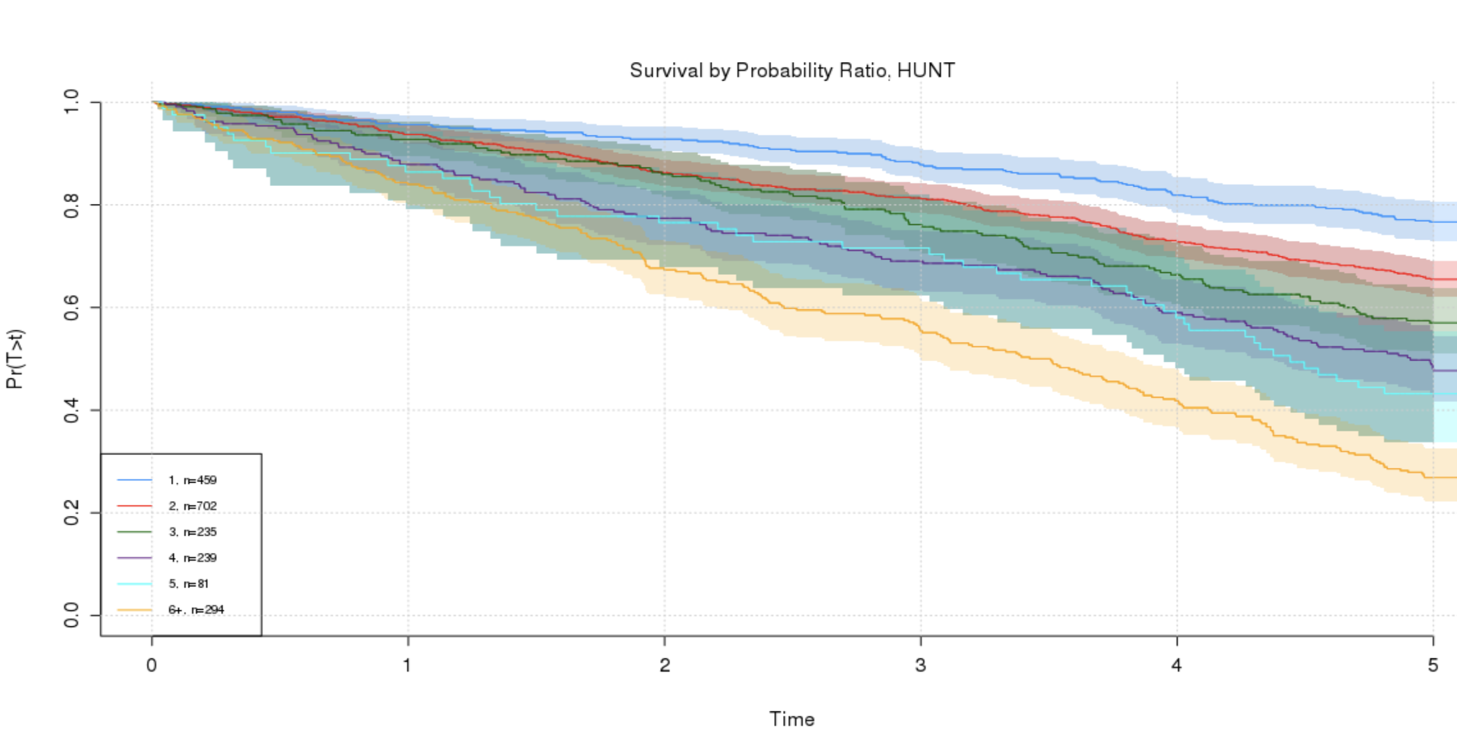
Cardiovascular primary event prediction
Key sources of data used:
Training and testing of model in people without known disease: HUNT 3 (Norway)
Independent replication set from UK
Predefined minimum performance criteria
A positive Net Reclassification Index (NRI) when compared with ACC risk score
Model output:
6 categories, 1 to ≥6 fold increase in risk
Actual performance
The model has 27 features
The NRI vs. ACC was positive
<1x
2x
Protein model stratified
event-free survival
3x
4x
5x
>6x
0
5
Time (years)
Dataset | Number of Subjects | NRI in people with events (%) | NRI in people with no events (%)
Training (50% with events) | 2464 | 11 | 14
Independent replication | 265 | 13 | 7

Slide 19
Diabetes risk prediction
Best glucose tolerance model
Key source of data used:
UK cohort pre-diabetic fraction, 413 subjects, 178 developed diabetes in 15 year follow-up
Results verified on a 20% fraction not used for training
Predefined minimum performance criterion:
Predict the likelihood of a diabetes diagnosis with equal to or better performance than oral glucose tolerance testing
Model output:
2 categories: ≥3x increase in risk or “typical”
Actual performance:
The model has 375 features
The % correct predictions of diabetes within 10 years is substantially greater than the best glucose tolerance model
Proportion without diabetes Dx
Protein model
Proportion without diabetes Dx

Slide 20
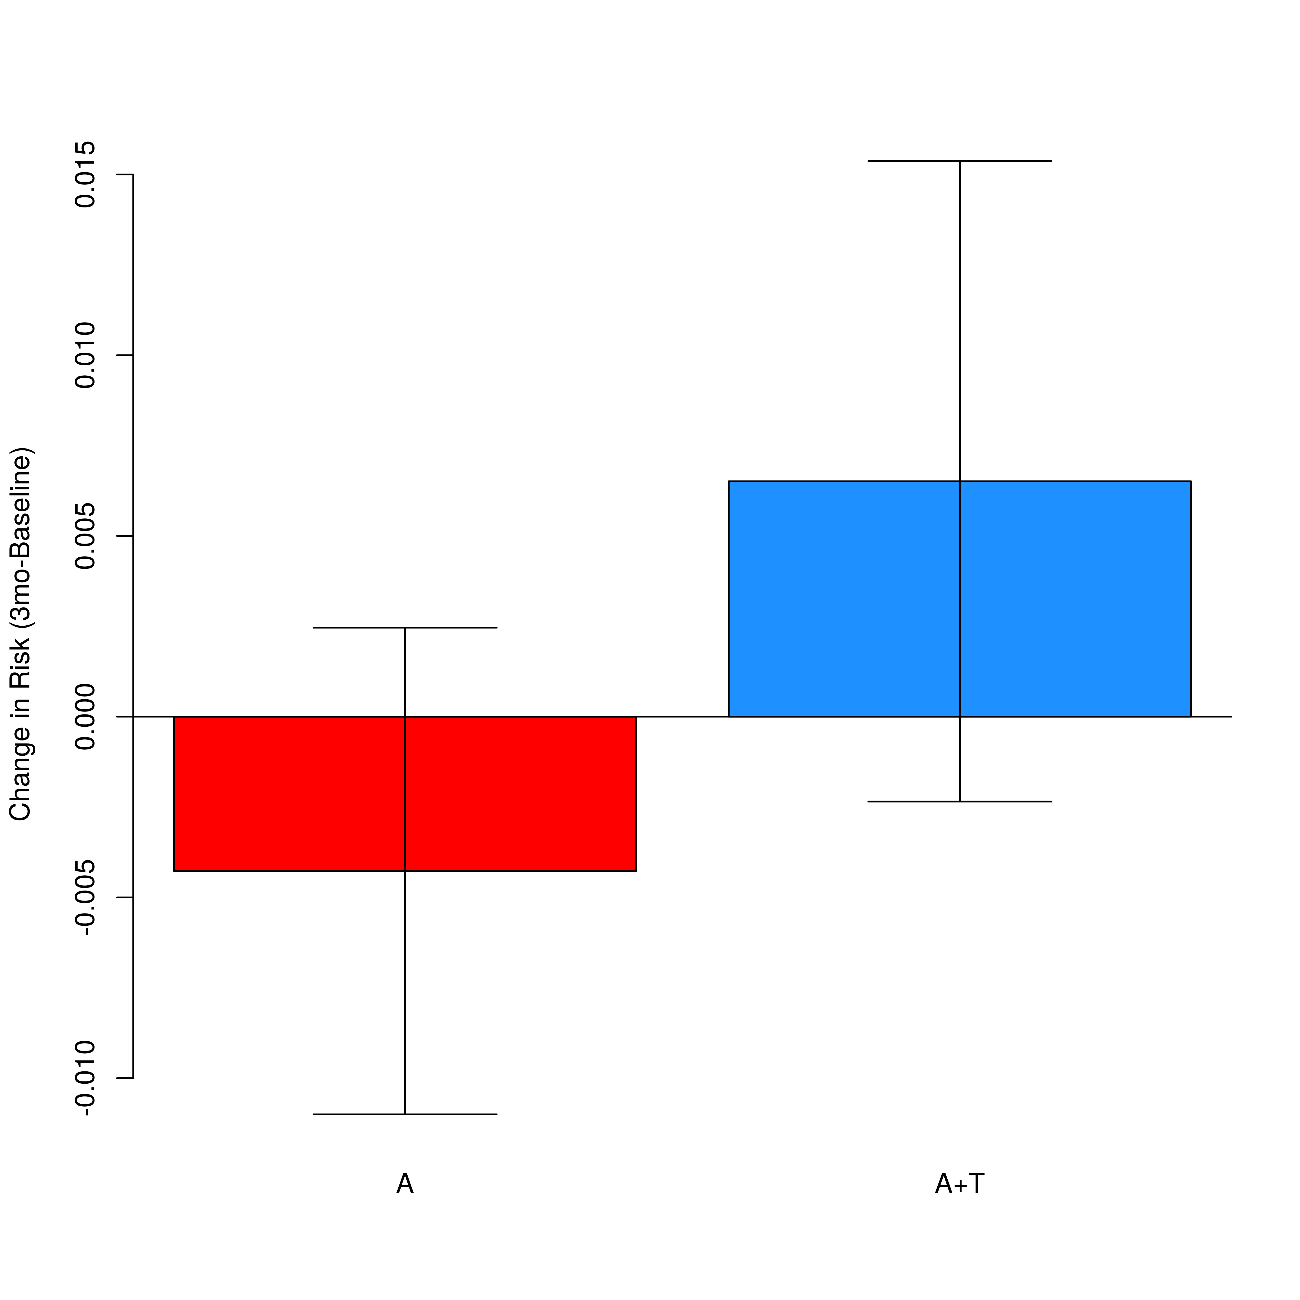
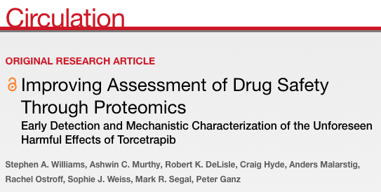
Early change in protein-based cardiovascular risk score heralds subsequent deaths
+0.65%
Change in Risk Score
p=0.0017
p = 0.056
-0.43%
Atorvastatin (A)
+Torcetrapib (T+A)
∆=1.08% p=0.0004
Predicted absolute risk difference is similar to observed difference in 18 month event rates

Slide 21
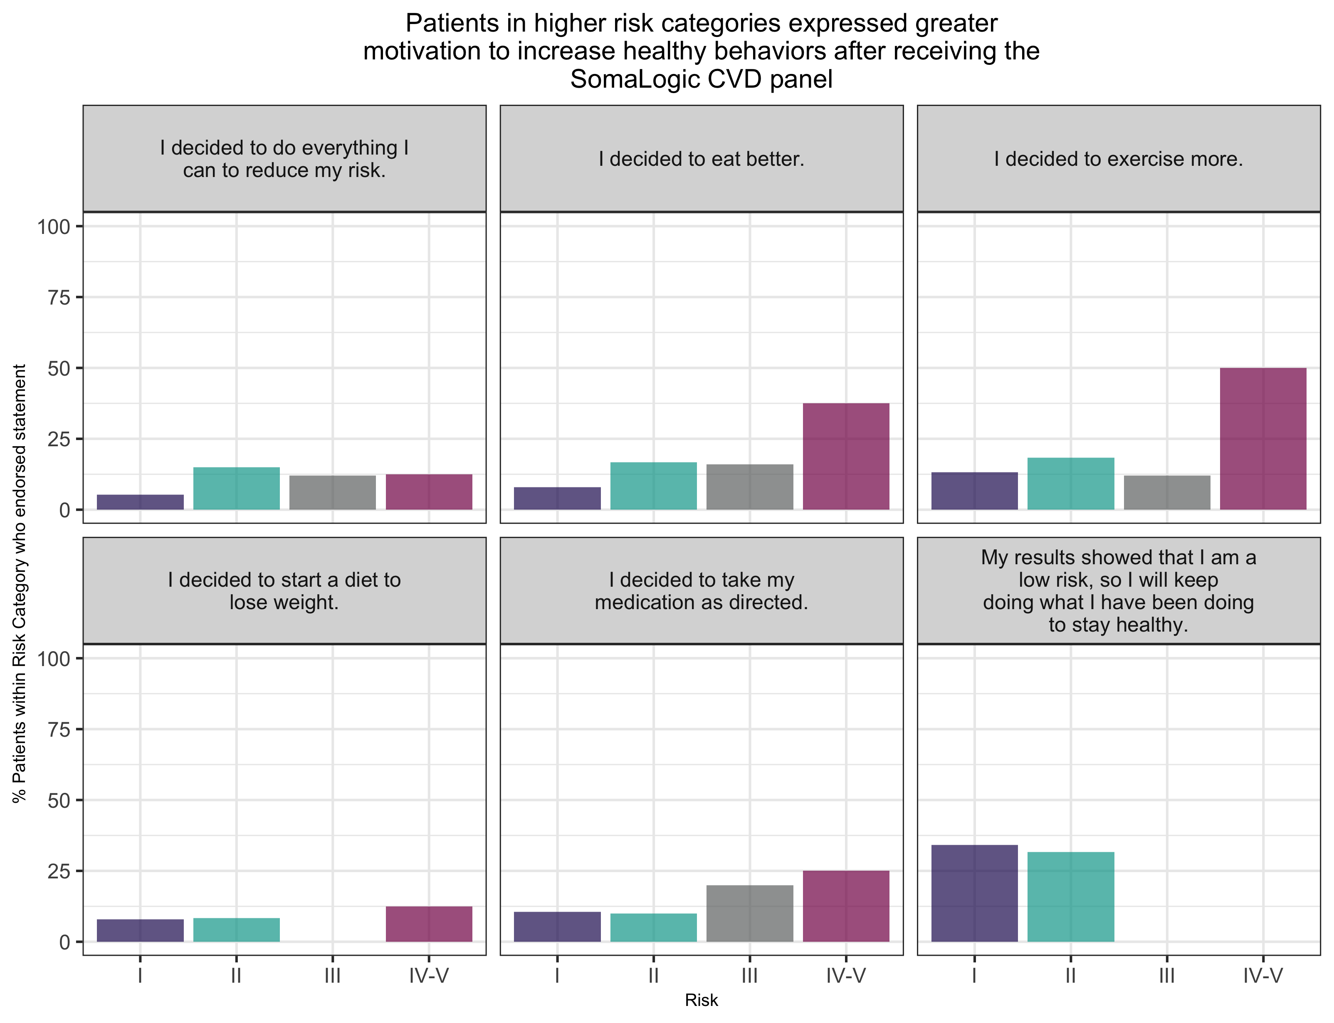
Initial prospective clinical experience
Boulder Community Hospital:
200 patients with CHD and well controlled cholesterol received their protein CV risk score in a cardiology setting
Their behavior change related to their individual risk [right panel, presented at AHA this week]
Exercise, weight and medication adherence were the key effects
Leeds Center for Personalized Medicine and Health
Primary care setting, patients with pre-diabetes
Up to 1000 patients have started receiving a report containing the first 8 models
Primary endpoint is change in patient activation
Secondary endpoint is enrollment in the diabetes prevention program

Slide 22
Summary/conclusions
Plasma protein scanning (SOMAscan) shows that proteins are a viable single information source for:
Current health states
Modifiable behaviors
Future health risks
New machine learning models can be rapidly developed and embedded on the platform as software “apps”
The pipeline will enable evaluation of >100 new models
The performance of the models is already sufficiently good to replace some imaging, treadmill, laboratory and clinical assessments

Slide 23
Appendix

Slide 24
The SOMAscan proteome as a comprehensive health information source: Recent peer reviewed publications
Chemotherapy (Haemotologia 2018)
Autoimmunity (Cell Mol Immunol 2018)
Diet and obesity (Int J Obesity 2018)
Bone fracture healing (J Orthop Res 2018)
Liver – NASH (J Hepatol 2018)
Nutrition and weight loss (Proteomics Clin App 2018)
Lung disease (EMBO Mol Med 2017
Multiple sclerosis (Ann Neurol 2017)
Body clock (Sci Rep 2017)
Normal pregnancy (AM J Obs Gyn 2017)
Myocardial infarction (Circulation 2017)
HIV therapy (JCI insight 2017)
Vitamin deficiency (J Cachexia 2017)
Biology control networks (Science 2018)
Kidney injury (Kidney Int. Rep 2018)
Rheumatoid arthritis (Nature commun. 2018)
Healthy aging (Aging Cell 2018)
Joint injury (Cartilage 2018)
Pregnancy: pre-eclampsia (Hypertension 2018)
Lung: pulmonary fibrosis (Sci Rep 2018)
Relation to genetics (Nature 2018)
Cancer immunotherapy (Cytotherapy 2018)
Muscular dystrophy (J Cachexia 2018)
Metabolic syndrome (Genes Nutr 2018)
Sleep, circadian (Proc Natl Acad Sci 2018)
Cardiovascular risk (Circulation 2018)

Slide 25
Outline of our machine learning process
Run SOMAscan 5000 on well-adjudicated clinical samples in CAP/CLIA lab.
Example 1: Model exceeds predefined performance standards
Test model on blinded hold-out sets not used for training
Robustness to geography or demographics
Example 2: does not meet performance standard
Hypothesis-Free Discovery, Correlation with Truth Standard (e.g. outcomes)
Machine- Learning POC and Model Type Selection (typically 4 types)
Model Refinement & Finalization
Example 3: meets performance standard but inferior to #1
Sensitivity to change
Independent Replication & Key Feature Testing
Replication study 1
Replication study n
Model refinement, final feature selection and finalization
Assay QA/QC
Sample quality
Site to site variability
False discovery correction
Univariate Lists
Implementation on SOMAscan platform for CV Preventative Health & Clinical Trials
File the discovery statistical analysis plan to regulatory document vault
File the refinement statistical analysis plan for #1 to regulatory document vault
File the technical summary in regulatory document vault; initiate Development under Design Controls
Complete all phases of Design Controls, complete relevant regulatory requirements

